Slide 1
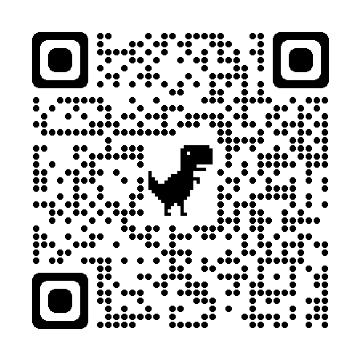
Molecular Biology & Biological Chemistry
https://bioscience.utah.edu/
Over 190 Faculty Members
11 Departments
Biochemistry
Biological Sciences
Chemistry
Human Genetics
Medicinal Chemistry
Microbiology & Immunology, Pathology
Molecular Pharmaceutics
Neurobiology
Nutrition & Integrative Physiology
Oncological Sciences
Pharmacology & Toxicology
Online Application
Domestic Application Fee Waiver
December 1 Deadline

